Slide 1
Bonneville Academy
Reading Achievement Throughout the School and Title I Overview
2026-2027

Slide 2
What is Title I?
Title I Part A, of the Elementary and Secondary Education Act (ESEA), provides financial assistance to districts and schools with high numbers of students from families who are considered “at-risk” or “disadvantaged”.
Economically disadvantaged, disabled, migrants, or those who have limited English proficiency.
The goal behind Title I is to “ensure all children have a fair, equal, and significant opportunity to obtain a high quality education and reach at least proficiency in state academic standards and assessments”.

Slide 3
Title I Fund Approaches
Title I provides funds to schools and districts to provide additional support and learning opportunities so all students can master the curriculum and meet the states challenging standards.
Two Approaches:
Targeted Approach: Only the percentage of students who are considered “at-risk” or “disadvantaged” are getting supports with funds.
Whole School Approach: Whole school regardless of students who considered “at-risk” or “disadvantaged” are getting supports based on needs.

Slide 4
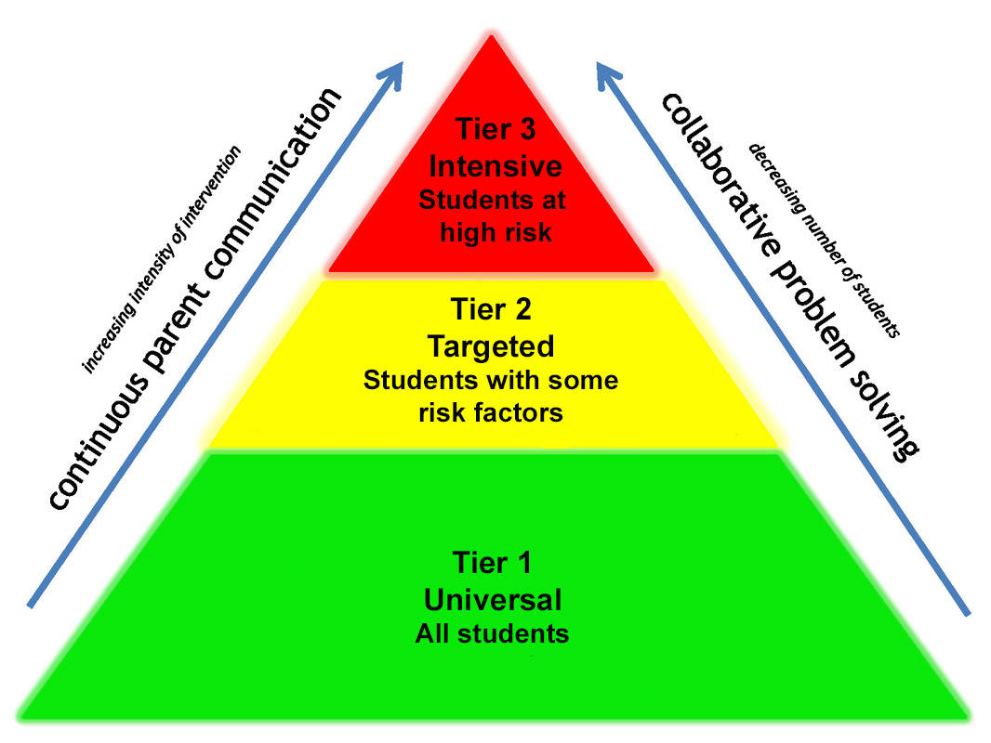
How does Bonneville Academy use
Title I Funds?
About 28% of students qualify as “at-risk” but there is also a large academic need.
Bonneville Academy has established that we will allocate these funds for tiered support for our students.

Slide 5
Why Use Title I for Tier 2 Support?

Slide 6
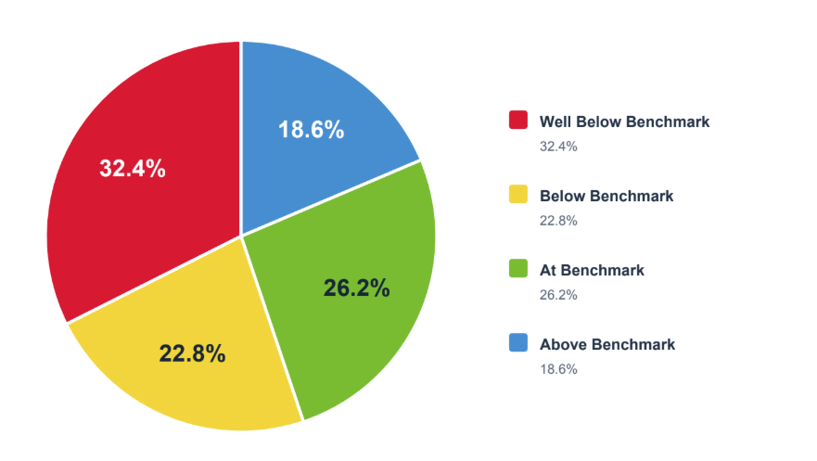
2026 Acadience Achievement

Slide 7
School Goals and Use of Title I Funds
Bonneville Academy’s Overarching Goal for the 2026-2027 School Year
Goal 1 - Mathematics
Bonneville Academy will improve student achievement in mathematics through targeted academic interventions, extended learning opportunities, additional instructional support, professional development, technology, instructional resources, and after-school programming.
Student progress will be measured using:
Grades K-3: Acadience Math assessments, with a goal of increasing the percentage of students meeting or exceeding benchmark expectations by at least 3 percentage points from Beginning of Year (BOY) to End of Year (EOY).
Grades 3-8: RISE Mathematics assessments, with a goal of increasing the percentage of students demonstrating proficiency by at least 3 percentage points compared to the previous school year.
Goal 2 – English Language Arts/Reading
Bonneville Academy will improve student achievement in English Language Arts (ELA) and reading through targeted academic interventions, extended learning opportunities, additional instructional support, professional development, technology, instructional resources, and before- or after-school programming.
Student progress will be measured using:
Grades K-3: Acadience Reading assessments, with a goal of increasing the percentage of students meeting or exceeding benchmark expectations by at least 3 percentage points from Beginning of Year (BOY) to End of Year (EOY).
Grades 3-8: RISE English Language Arts assessments, with a goal of increasing the percentage of students demonstrating proficiency by at least 3 percentage points compared to the previous school year.

Slide 8
How can you help in this process?
We know parents and family members are huge for student success and we thank you for all that you do!
Some are on school committees which plan and vote for things that our school needs.
Some volunteer in their child’s classroom.
Many work with their child at home to continue their learning and reach out to the teacher.
Plus so many other ways to help!

Slide 9
Parent Rights
Parents have a right to know:
  The curriculum and assessments the school uses
  The qualifications of the teachers and paraprofessionals
  The academic growth of their students
  Information regarding the Title I program and how funds are used
  The policies that are used to govern the Title I program

Slide 10
Parent Involvement
Parents will have the following opportunities to be involved/engaged at Bonneville Academy:
● Committee Member – Bonneville Academy will have a variety of committees including:
Governance, Parent Teacher Organization, School Trust Lands, Academic Excellence and other board and administration created committees
● Participate with the Parent Teacher Organization
● Volunteer in the general education classroom
● Attend special programs including: Concerts, art programs, STEM Fair, and any other school sponsored programs
● Annually parents will be asked for feedback regarding school policies and practices. Surveys will be made available to determine family and parent satisfaction.

Slide 11
Parent Engagement
Bonneville Academy will engage parents in the development of its Title I school plan and in the process of school review and improvement.
A Title I school plan committee will be created. The committee will meet at least twice per year.
The school will invite at least two parents to participate in the committee to help develop the school Title I plan. Parents will review information, attend scheduled meetings and give input in the development of the plan.
Achievement data will be shared with parents.
Parents will be invited to give input regarding academic goals.
Parents and faculty will discuss evidence-based instructional practices.
https://vahara-o5-public.s3.us-west-2.amazonaws.com/media/36483/Parent-Involvement-and-Engagement-Policy.pdf

Slide 12
Student-Parent-School Compact
Bonneville Academy believes that student success occurs when families, students, and school staff work together to help students reach their greatest potential. Each person plays a valuable role and each has their own responsibilities. It is when we combine those responsibilities that we reach our highest achievement ability!
https://vahara-o5-public.s3.us-west-2.amazonaws.com/media/35729/Student-Parent-School-Compact-Policy-.pdf

Slide 13
If you have any questions or concerns:
Juliette Herrera
Director
juliette.herrera@bonnevilleacademy.org
435-315-2080
Michael Spendlove
Academic/SPED Director
michael.spendlove@bonnevilleacademy.org
435-315-2080
To learn more about the Title I policies visit the Bonneville Academy website at this link: https://bonnevilleacademy.org/policies/

