Slide 1
Title IX Symposium – September 30, 2021 The Jeff & Jeff Writing Workshop Jeffrey D. Peterson, Nebo School District Jeffrey K. Christensen, Canyons School District

Slide 2
Roadmap
Part 1: Overview of Investigative Documents
The Investigative Report
Notices & Other Correspondence
The Written Determination
Part 2: Fundamentals
Purpose
Audience
Format
Content
Part 3: Writing Tips
Plain Language
Grammar
Mechanics
Proofreading and Editing

Slide 3
Part 1: Overview of Investigative Documents
The Investigative Report - 106.45(b)(5)(vii)
Create an investigative report that fairly summarizes relevant evidence

Slide 4
Part 1: Overview of Investigative Documents
The Investigative Report
Review Breakouts

Slide 5
Part 1: Overview of Investigative Documents
The Investigative Report
Templates, samples, and alternative formats

Slide 6
Part 1: Overview of Investigative Documents
Notices & Correspondence
1. Notice of Grievance Process - 106.45(b)(2)(i)(A)
Upon receipt of a formal complaint, you must provide the following written notices to the parties who are known:
(A) Notice of your grievance process
(B) Notice of the allegations

Slide 7
Part 1: Overview of Investigative Documents
Notices & Correspondence
2. Notice of Grievance Process - 106.45(b)(2)(i)(B)
Upon receipt of a formal complaint, [you] must provide the following written notices to the parties who are known:
(A) Notice of [your] grievance process…
(B) Notice of the allegations of sexual harassment

Slide 8
Part 1: Overview of Investigative Documents
Notices & Correspondence
2. Notice of Grievance Process - 106.45(b)(2)(i)(B)
Notice of Allegations must include
Identities of parties
Conduct alleged
Date and location of incident
Statement that respondent is presumed not responsible
Statement that determination is made at conclusion of investigation
Statement that parties may have an advisor
Statement that they may inspect and review evidence
Statement prohibiting false statements

Slide 9
Part 1: Overview of Investigative Documents
Notices & Correspondence
3. Notice of Dismissal - 106.45(b)(3)(iii)
Upon a dismissal required or permitted pursuant to paragraph (b)(3)(i) or (b)(3)(ii) of this section, you must promptly send written notice of the dismissal and reason(s) therefor simultaneously to the parties.

Slide 10
Part 1: Overview of Investigative Documents
Notices & Correspondence
4. Notice of Consolidation of Complaints - 106.45(b)(4)
The Regs allow you to consolidate formal complaints. No written notice is required, but we recommend it.

Slide 11
Part 1: Overview of Investigative Documents
Notices & Correspondence
5. Notice of Meeting - 106.45(b)(5)(v)
When investigating a formal complaint and throughout the grievance process, you must provide, to a party whose participation is invited or expected, written notice of the date, time, location, participants, and purpose of all hearings, investigative interviews, or other meetings, with sufficient time for the party to prepare to participate.

Slide 12
Part 1: Overview of Investigative Documents
Notices & Correspondence
6. Notice of Informal Resolution Process - 106.45(b)(9)
You may facilitate an informal resolution process, such as mediation, as long as you
Provide to the parties a written notice disclosing:
The allegations
The requirements of the informal resolution process
Any consequences resulting from participating in the informal resolution process

Slide 13
Part 1: Overview of Investigative Documents
Notices & Correspondence
7. Notice of Emergency Removal - 106.44(c)
You may initiate an emergency removal of a respondent based on a safety analysis. If you do, you must provide the respondent with notice and an opportunity to challenge the decision immediately following the removal.

Slide 14
Part 1: Overview of Investigative Documents
Notices & Correspondence
8. Notice of Appeal - 106.45(b)(8)(iii)(A)
As to all appeals, you must:
Notify the other party in writing when an appeal is filed and implement appeal procedures equally for both parties.

Slide 15
Part 1: Overview of Investigative Documents
Notices & Correspondence
9. Notice of Decision of Appeal - 106.45(b)(8)(iii)(E)-(F)
As to all appeals, you must:
(E) Issue a written decision describing the result of the appeal and the rationale for the result; and
(F) Provide the written decision simultaneously to both parties.

Slide 16
Part 1: Overview of Investigative Documents
Notices & Correspondence
10. Notice of Delay or Extension - 106.45(b)(1)(v)
Your grievance process must include reasonably prompt time frames and a process that allows for the temporary delay of the grievance process or the limited extension of time frames for good cause with written notice to the complainant and the respondent of the delay or extension and the reasons for the action.

Slide 17
Part 1: Overview of Investigative Documents
Notices & Correspondence
11. Responding to Party or Witness Questions
Throughout the process it is common for parties and witnesses to have questions for coordinators, investigators, and decision-makers. The Regs do not address how a district should respond to questions. You can decide whether to respond verbally or in writing. If you respond in writing, follow the tips in this presentation.

Slide 18
Part 1: Overview of Investigative Documents
Notices & Correspondence
12. Requests for Information
An investigator will likely have follow-up questions after an interview or after receiving evidence. You may decide to ask these questions verbally; however, you likely need to give written notice and sufficient time to prepare (see Notice of Meeting above). You may also decide to ask these follow-up questions via email or other written correspondence. If you do, follow the writing tips in this presentation.

Slide 19
Part 1: Overview of Investigative Documents
Notices & Correspondence
13. Notice of Transition from Investigator to Decision-Maker
The Regs do not require this, but at some point in the process the investigator finishes the investigative report, and the decision-maker takes over to give the parties a chance to ask their questions. This process and transition should be communicated clearly to the parties.

Slide 20
Part 1: Overview of Investigative Documents
Notices & Correspondence
14. Exclusion of Questions – 106.45(b)(6)(ii)
The decision-maker “must explain to the party proposing the questions any decision to exclude a question as not relevant.” The Regs don’t require that this explanation be in writing, but we recommend it.

Slide 21
Part 1: Overview of Investigative Documents
Notices & Correspondence
15. Record of Actions – 106.45(b)(10)(ii)
For each response required by the Regs, you must create, and maintain for a period of seven years, records of any actions, including any supportive measures, taken in response to a report or formal complaint of sexual harassment.

Slide 22
Part 1: Overview of Investigative Documents
Notices & Correspondence
16. Cover Letters or Emails
The Regs require that certain documents be given to each party. The Regs do not require any kind of explanation or cover letter to be sent with the required documents, but an effective investigation will provide some explanation.

Slide 23
Part 1: Overview of Investigative Documents
Written Determination - 106.45(b)(7)(i)
The decision-maker(s), who cannot be the same person(s) as the Title IX Coordinator or the investigator(s), must issue a written determination regarding responsibility.

Slide 24
Part 1: Overview of Investigative Documents
Written Determination - 106.45(b)(7)(ii)
The written determination must include
Identification of the allegations
A description of the procedural steps
Findings of fact
Conclusions
A statement of, and rationale for, the result
Your procedures for appeal

Slide 25
Part 1: Overview of Investigative Documents
Written Determination - 106.45(b)(7)
Review Breakouts

Slide 26
Roadmap
Part 1: Overview of Investigative Documents
The Investigative Report
Notices & Other Correspondence
The Written Determination
Part 2: Fundamentals
Purpose
Audience
Format
Content
Part 3: Writing Tips
Plain Language
Grammar
Mechanics
Proofreading and Editing

Slide 27
Part 2: Fundamentals
Purpose
What is the purpose of each of these?
Investigative Report
Notices
Correspondence
Written Determination

Slide 28
Part 2: Fundamentals
Purpose
Ask yourself, “What am I trying to accomplish?”
provide notice
summarize the evidence
inform parties as to the facts
analyze policy to facts
respond to questions from the parties
document the Title IX process
To accomplish a specific purpose, you must effectively convey your points in writing to the intended audience.

Slide 29
Part 2: Fundamentals
Purpose
Examples & Exercises

Slide 30
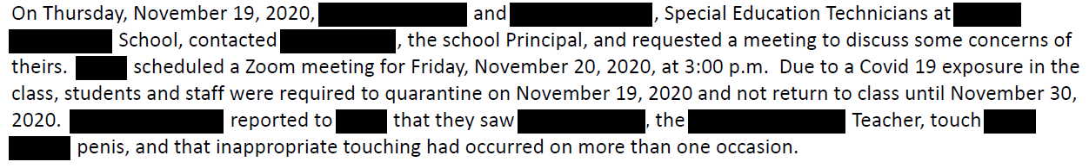
Part 2: Fundamentals
Purpose

Slide 31
Part 2: Fundamentals
Audience
Generally
Who is this for?
What do you know about them?
What do they already know/not know?
What will they do with it?
Who else will read it?

Slide 32
Part 2: Fundamentals
Audience
The audience is the initial reader of the document, the person or people it was written to.
For example, the audience of the investigative report includes the complainant, the respondent, the decision-maker(s), party advisors, and attorneys.
The Regs require that records be maintained for seven years. Over those years, who else may be included in your audience?
Parents/legal guardians; district and school personnel (administrators; human resources); decision-maker(s); the court; law enforcement.
As you develop written records, it is important to review issues of confidentiality and to consider to whom the written document may be distributed.

Slide 33
Part 2: Fundamentals
Format
Select a writing format/template for use. If you have several templates available, find one that effectively meets your purpose and audience.
Evaluate the templates and study effective examples.

Slide 34
Part 2: Fundamentals
Format
Review samples of the following.
Investigative Report
Notices
Correspondence
Written Determination

Slide 35
Part 2: Fundamentals
Content
This is the what of your document.
The content will depend upon applicable statutes and rules and the purpose of the document.
Content is based on the intended message for your audience and comes from interviews, facts, other evidence, your own analysis, etc.
Particular tips or considerations for content include:
Verify and adhere to governing law, including statutes and rules;
Avoid misstating the law or facts;
In the end, did you say what you wanted to say?

Slide 36
Part 2: Fundamentals
Content
Where do you get the content for each of these?
Investigative Report
Notices
Correspondence
Written Determination

Slide 37
Roadmap
Part 1: Overview of Investigative Documents
The Investigative Report
Notices & Other Correspondence
The Written Determination
Part 2: Fundamentals
Purpose
Audience
Format
Content
Part 3: Writing Tips
Plain Language
Grammar
Mechanics
Proofreading and Editing

Slide 38
Part 3: Writing Tips
Plain Language
Words should be simple and easily understood by your audience. Avoid stuffy, overly formal, unnatural words.
Sentences should be concise.
Paragraphs should contain one, and only one, main idea.

Slide 39
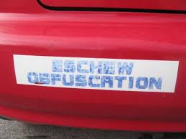
Part 3: Writing Tips
Plain Language

Slide 40
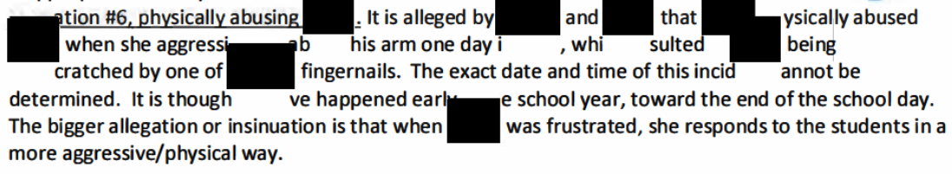
Part 3: Writing Tips
Plain Language
Exercise
How would you rewrite this paragraph?

Slide 41
Part 3: Writing Tips
Grammar and Usage
Find and refer to a grammar and usage book regularly.
Be careful with pronouns.
Use complete sentences.
Be careful with words with a distinct legal meaning, a “term of art” (e.g. retaliate).
Maintain a consistent point of view

Slide 42
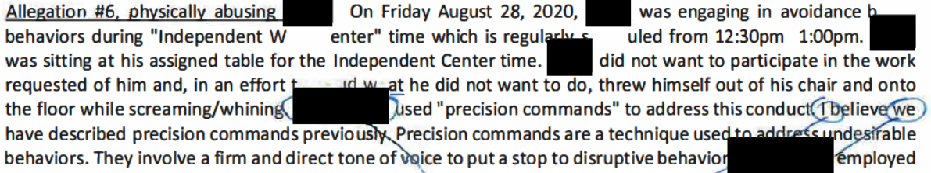
Part 3: Writing Tips
Grammar and Usage
What pronoun problems do you see here?

Slide 43
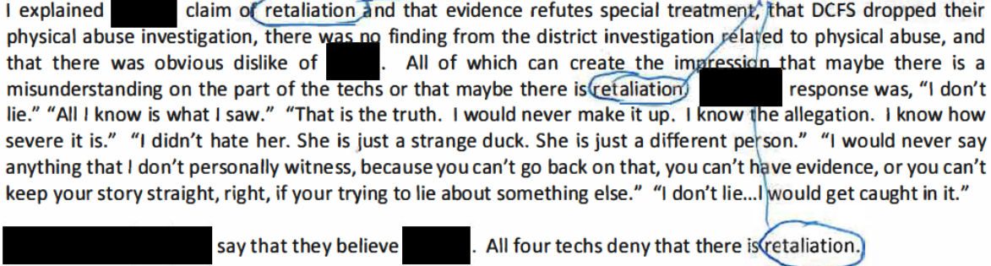
Part 3: Writing Tips
Grammar and Usage
What does retaliation mean?

Slide 44
Part 3: Writing Tips
Mechanics
Quotations
Commas
Ellipses
Brackets
Periods
Apostrophes
Bullets
Capitalization
Italics, Bold, and Underlining
Numbers
Plurals and Possessives

Slide 45
Part 3: Writing Tips
Mechanics
Quotations
Make it obvious
Quotation marks for quotes under 50 words or 5 lines
Block quotes for everything else

Slide 46
Part 3: Writing Tips
Mechanics
Quotations

Slide 47
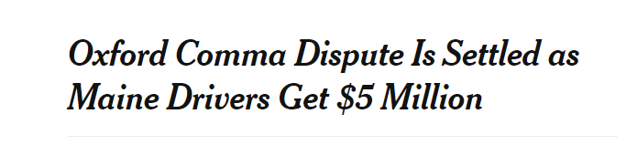
Part 3: Writing Tips
Mechanics
Commas
Pairs
Lists
With conjunctions
Dependent clauses

Slide 48
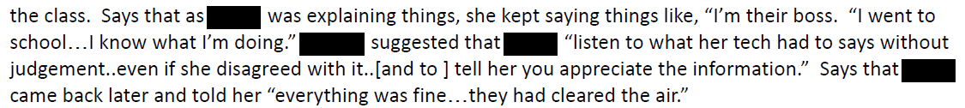
Part 3: Writing Tips
Mechanics
Ellipses
Use three dots to indicate omission of one or more words in a quotation
Use four dots to indicate omission of end of a sentence
Do not use ellipses at beginning of quotation or where quoted matter is worked into the sentence.
Use spaces between words and ellipsis dots
Use hard spaces between dots (ctrl+shift+space in MS Word)

Slide 49
Part 3: Writing Tips
Mechanics
Brackets
Use brackets to insert a clarification in quoted material
Use brackets to show the original quotation has been modified
Use empty brackets to show part of a quoted word has been omitted
For example, if the text you’re quoting used “related” but the syntax of your document needs “relate,” show the modification as “relate[].”

Slide 50
Part 3: Writing Tips
Mechanics
Periods
End most sentences with periods
You will probably never need an exclamation point unless quoting
Use a period after a heading if the heading is a complete sentence
Use periods after letters or numbers in an outline or list

Slide 51
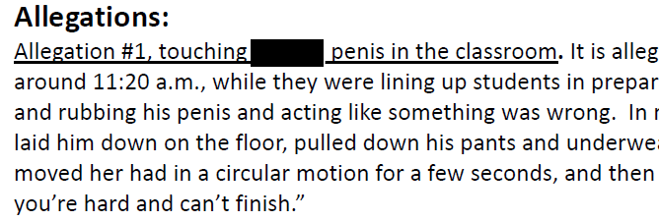
Part 3: Writing Tips
Mechanics
Periods

Slide 52
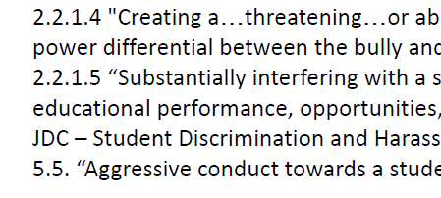
Part 3: Writing Tips
Mechanics
Periods

Slide 53
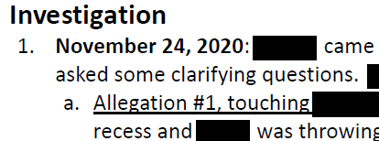
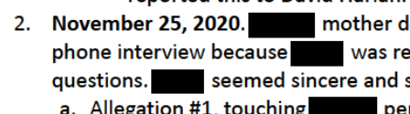
Part 3: Writing Tips
Mechanics
Periods

Slide 54
Part 3: Writing Tips
Mechanics
Apostrophes
Forms the possessive case
Stands for missing letters in contractions
Very very very very rarely forms the plural of certain expressions
Smiths
She received Bs and Cs on her report card
She received A’s on her report card (used here to avoid miscue)
He owns hundreds of CDs

Slide 55
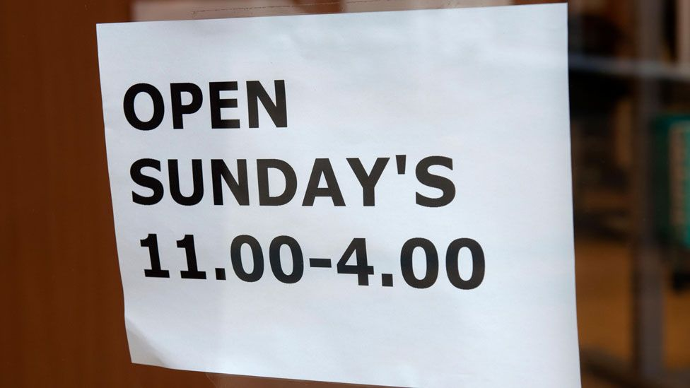
Part 3: Writing Tips
Mechanics
Apostrophes

Slide 56
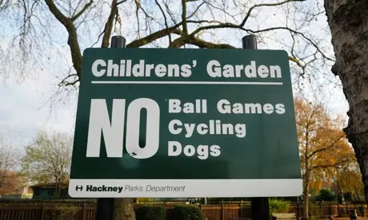
Part 3: Writing Tips
Mechanics
Apostrophes

Slide 57
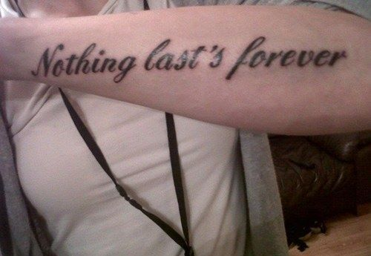
Part 3: Writing Tips
Mechanics
Apostrophes

Slide 58

Part 3: Writing Tips
Mechanics
Apostrophes

Slide 59
Part 3: Writing Tips
Mechanics
Bullets
May highlight important lists
May comprise single words, phrases, clauses, or sentences
Must be parallel in form
Must be punctuated (or not) consistently
Must be capitalized if items end in period

Slide 60
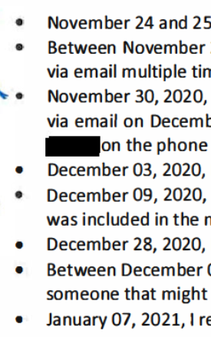
Part 3: Writing Tips
Mechanics
Bullets

Slide 61
Part 3: Writing Tips
Mechanics
Capitalization
Capitalize first word in a sentence (even if normally lower case, like iPad)
Capitalize names (if person prefers it that way)
Capitalize first word of a quotation if it is a full sentence
Don’t capitalize first word of a quotation if it is a partial sentence, is grammatically woven into the main sentence, or is introduced by “that”
Use brackets to change capitalization of first word of a quote if it is changed from the original
Capitalize proper nouns

Slide 62
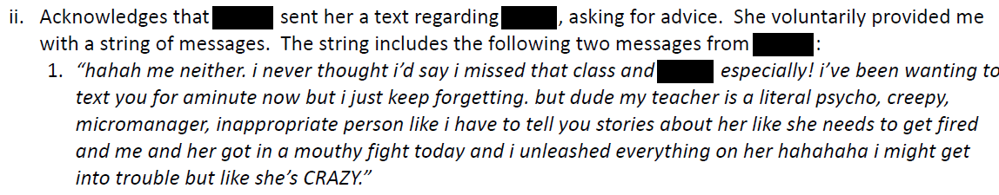
Part 3: Writing Tips
Mechanics
Capitalization

Slide 63
Part 3: Writing Tips
Mechanics
Italics, Bold, and Underlining
Only two possible reasons for making text stand out:
(1) to emphasize it; or (2) to comply with a style convention.
Use italics to show emphasis, or signal a letter, word, or phrase is being used as a term.
Use bold typeface for headings.
Avoid underlining altogether.

Slide 64
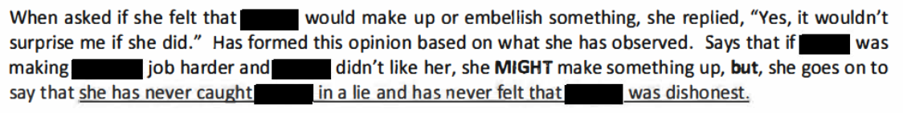
Part 3: Writing Tips
Mechanics
Italics, Bold, and Underlining

Slide 65
Part 3: Writing Tips
Mechanics
Numbers
Be Consistent - Numerals vs. spelling out numbers, it is a matter of setting a style
Spell out numbers 1-10, but use numerals 11 and above.
Use cardinals for most purposes (one, two three), but use ordinals to indicate position in a series (first, second, third)
Never begin a sentence with a numeral
Use numerals for statutes, sections, in tables, and money.
Spell out a large number used for exaggeration (hundreds or millions).
Use simplest forms for times, dates, and money.
The 911 call was placed at 3:47 p.m.
A $10 bill was left on the counter.
The check was for exactly $10.37.

Slide 66
Part 3: Writing Tips
Mechanics
Plurals and Possessives
The plural of most regular nouns is formed by adding s or es
Words ending in s or other sibilant sound (z, x, sh, ch).
Boxes, benches, cases, justices
Add an apostrophe followed by an s to the end of a word to form the possessive of (1) a singular noun or (2) a plural noun that does not end in s or z.
Boy’s, girl’s, child’s, children’s
Add an apostrophe to the end of regular plural to form a plural possessive, even if it ends in s or z.
Boys’ girls’, boxes’

Slide 67
Part 3: Writing Tips
Proofreading and Editing
Orwell’s Six Questions
What am I trying to say?
What words will express it?
What image or idiom will make it clearer?
Is this image fresh enough to have an effect?
Could I put it more shortly?
Have I said anything that is avoidably ugly?

Slide 68
Part 3: Writing Tips
Proofreading and Editing
Edit in a phased approach, making several passes in the document.
Large structural edits
Sentence-level edits
Subtler sentence-level edits
Polish for clarity

Slide 69
End

