Slide 1

Title IX Coordinator Training
What is your role?
Darin Goff
Assistant Utah Attorney General

Slide 2
Overview
CHOOSING A TITLE IX COORDINATOR
WHAT ARE THE RESPONSIBILITIES OF THE TITLE IX COORDINATOR?
WHERE CAN I GET HELP?

Slide 3
How many Title IX Coordinators can I have?
As many as you want—but you need to have at least one who will not be a decision-maker or an individual designated to hear appeals.
Remember, you must train your Title IX Coordinator (TIXC), so only designate as many TIXCs as you are willing to invest the time and resources into training.

Slide 4
Widespread Notification of Designated Title IX Coordinators
You must notify all applicants (for admission or employment), students, parents or legal guardians, employees, and any recognized employee associations of the name or title, office address, e-mail address, and telephone number of the designated TIXC.
This information must be:
on your website, and
in each handbook or catalog that you make available to the individuals identified above

Slide 5
How do I choose a Title IX Coordinator?
Your TIXC needs to:
be independent and unbiased;
be able to communicate and coordinate effectively;
be able to prepare written reports and documentation on Title IX compliance activities as well as make recommendations for action;
be able to diagnose, clarify, and mediate differences of opinion; and
have the authority or access necessary to enforce compliance requirements.

Slide 6

What are the responsibilities of the Title IX Coordinator?

Slide 7
Title IX Coordinator
“The Title IX Coordinator has a responsibility to coordinate the recipient's efforts to comply with its obligations under Title IX and the Title IX regulations. These responsibilities include coordinating any investigations of complaints received pursuant to Title IX and the implementing regulations.”
—Department of Justice

Slide 8
Responsibilities of Title IX Coordinators
Ensure that the LEA’s grievance process is current, published, and accessible
Ensure that the LEA has assigned individuals to each Title IX role and that they are appropriately trained
Publish the training each individual has received
Ensure reports of sex discrimination/sexual harassment can be made at any time (24/7)
Provide consultation, information, and grievance forms to potential complainants/respondents—especially about supportive measures
Oversee implementation of grievance procedures, e.g., provide notices, monitor timelines, schedule various meetings, make initial assessment of applicability of Title IX to situation

Slide 9
Responsibilities of Title IX Coordinators (continued)
Notify all parties regarding decisions, and ensure implementation of any remedies/consequences
Notify complainants of the right and procedures of appeal
Maintain grievance and compliance records and files
Provide ongoing training, consultation, technical assistance, and information services regarding Title IX requirements, grievance issues, and compliance programs
Notes:
https://www.justice.gov/crt/federal-coordination-and-compliance-section-152

Slide 10
Let’s take these one at a time…

Slide 11
Ensure your process and procedures are compliant!
Written grievance procedures for dealing with sexual harassment must abide by the new regulations.
These must already be in place.
The grievance process cannot discriminate against a Complainant or a Respondent on the basis of sex or status.
Practices must apply equally to both parties.
The remedies for a Complainant must be designed to restore or preserve equal access to the school’s education program or activity.

Slide 12
Ten Requirements of Grievance Process
Treat parties equitably
Objectively evaluate credibility and all relevant evidence
Train staff and ensure there is no conflict of interest/bias
Include a presumption that the Respondent is not responsible for alleged conduct
Establish reasonably prompt timeframes
Describe/list the range of possible disciplinary sanctions/remedies
State the standard of evidence (POE or CCE)
Include the procedures and permissible bases for the parties to appeal
Describe the range of supportive measures
Clarify that privileged information will not be used/sought without individual’s consent

Slide 13

Quiz Time
Tell me what must be in your grievance process

Slide 14

Title IX Process Flowchart

Slide 15
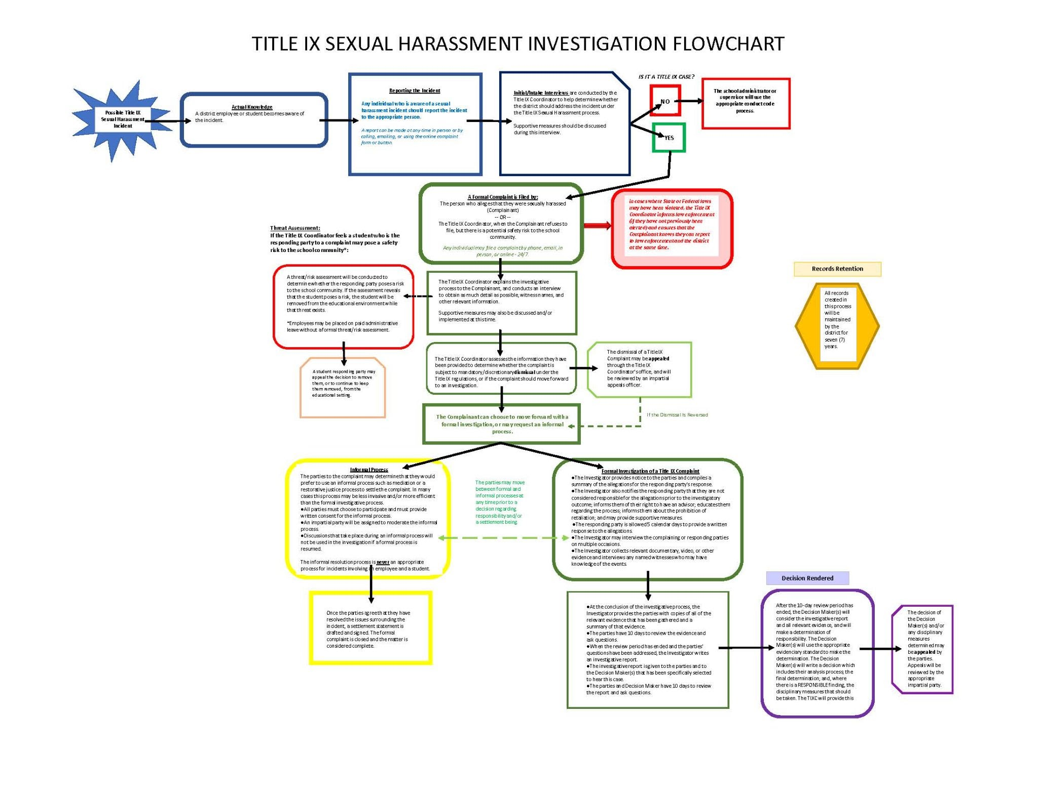

Slide 16

Who can make a report of sexual harassment?
Anyone can report sexual harassment within a school’s education program or activity, triggering the Title IX Coordinator’s responsibility to act.
Remember, the reporter is not necessarily the Complainant.

Slide 17
Actual Knowledge When are you on actual notice and what should you do?
K-12 schools are deemed to be on notice when any employee has notice of allegations of sexual harassment (as defined in §106.30). Such notice triggers the LEA's response obligations and liability if the LEA does not act appropriately.

Slide 18
Obligations Upon Notice
Once a school has “actual knowledge” of sexual harassment or allegations of sexual harassment, that activates the LEA’s legal obligation to respond promptly in a manner that is not deliberately indifferent.
A school must treat a person as a Complainant any time the school has notice that the person is alleged to be the victim of conduct that could constitute sexual harassment (regardless of whether that person or a third party reported the sexual harassment), and irrespective of whether the Complainant chooses to file a formal complaint.
There is no time limit or statute of limitations on a Complainant’s decision to file a formal complaint.

Slide 19
What is the definition of sexual harassment?
Conduct on the basis of sex that satisfies one or more of the following:
An employee of the LEA conditioning the provision of an aid, benefit, or service of the district on an individual’s participation in unwelcome sexual conduct (quid pro quo);
Unwelcome conduct determined by a reasonable person to be so severe, pervasive, AND objectively offensive that it effectively denies a person equal access to the school’s education program or activity; and
Conduct that could be considered sexual assault, dating violence, domestic violence, and/or stalking.

Slide 20
Quiz Time
What constitutes sexual harassment?

Slide 21
Intake
An intake interview should be conducted with the Complainant to determine if the allegations fall under the purview of Title IX:
Did the alleged incident occur within the school’s educational program or activity?
Is the individual who was alleged to have been harmed participating in/trying to participate in the school’s educational program or activity?
Does the alleged behavior (if true) fall within the definition of sexual harassment in §106.30?
Did the alleged behavior occur within the United States?
Notes:
Including locations, events, or circumstances over which the recipient exercised substantial control over both the R and the context in which the SH occurred.

Slide 22
Inform
The Title IX Coordinator must promptly contact the Complainant (if the report was made by someone else) to discuss the availability of supportive measures, which are available with or without the filing of a formal complaint;
Consider the Complainant’s wishes with respect to supportive measures.
Explain to the Complainant the process for filing a formal complaint and the grievance process.

Slide 23
Information given to the Complainant about the process should include:
the policies/procedures containing the Title IX grievance process;
explanation of behaviors that would constitute sexual harassment and/or any code of conduct violations;
that the Respondent is presumed not responsible and that both parties have equal rights and protections;
that the parties are entitled to an advisor of their choice;
that both parties will have an opportunity to inspect and review evidence;
that retaliation for participating in the Title IX grievance process is prohibited;
an explanation that the parties can choose to engage in informal resolution instead of a formal grievance process;
the range of possible remedies and/or disciplinary sanctions following a determination of responsibility; and
the standard of evidence that will be used to reach a determination.
Notes:
Must be sent simultaneously to both parties. Schools don’t have to offer informal resolution processes, but if they choose to it’s important that they are mentioned in initial notice to the parties. OCR offers a Facilitated Resolution Between the Parties (FRBP)

Slide 24
Examples of supportive measures
Requirements
Non-disciplinary, non-punitive, individualized
Not unreasonably burdensome to other party
Free of charge
Protect safety of parties and educational environment
Confidential to extent possible
Examples
No contact orders
Academic accommodations
Schedule modifications
Counseling
Health and mental health services
Disability services
Notes:
Always looking at restoring or preserving equal access to the education program/activity

Slide 25
Who can file a formal complaint?
Complainant (alleged victim)
Parent/guardian of a minor Complainant
The Tile IX Coordinator

Slide 26
Things Title IX Coordinators should consider when determining whether to sign a complaint
If the Complainant refuses to sign a formal complaint, the TIXC has the authority to sign a formal complaint (remember, the TIXC does not become the Complainant in this instance).
The following circumstances might justify the TIXC taking this step:
The LEA has actual knowledge of a pattern of alleged sexual harassment by an individual in a position of authority;
The TIXC receives multiple reports of sexual harassment against the same individual; and
The report involves violence, weapons, and other similar factors that heightens the level of severity.

Slide 27
Informal v. Formal Grievance Processes
Informal Process (no signed complaint)
Supportive measures
Title IX Coordinator is responsible to ensure supportive measures are implemented as agreed
Formal Process (with signed complaint)
Investigation, determination, and appeal
Informal resolution
Supportive measures
Title IX Coordinator is responsible for ensuring that the resolution (either through informal resolution, supportive measures, or a decision by a decision maker(s)) is enforced.

Slide 28
Formal Grievance Process

Slide 29
Process must be “reasonably prompt” What does this mean?
The Department believes that recipients (LEAs) are in the best position to designate “reasonably prompt time frames” that balance the need to conclude Title IX grievance processes promptly with providing the fairness and accuracy that these final regulations require.
This provision does not permit a recipient to conduct a grievance process without a “set” time frame. You are thus required to designate and include in your grievance process what the set time frame will be for each phase of the grievance process (including appeals and any informal resolution process).
Notes:
What if law enforcement is involved? USDOE believes that categorically prohibiting delays based on concurrent law enforcement investigations would deprive recipients of flexibility to work effectively and appropriately with law enforcement where the purpose of both the criminal justice system and the Title IX grievance process is to protect victims of sexual misconduct, and this discretion is appropriately balanced by not permitting a recipient to apply a delay or extension (even for good cause) that is not “temporary” or “limited.” For similar reasons, the Department declines to specify a particular number of days that constitute “temporary” delays or “limited” extensions of time frames. State laws that do specify such maximum delays may be complied with by recipients without violating these final regulations, because § 106.45(b)(1)(v) allows but does not require a recipient to implement short-term delays even for good cause. The Department also reiterates that nothing in the final regulations precludes recipients from offering supportive measures to one or both parties while the grievance process is temporarily delayed, and revised § 106.44(a) obligates a recipient to offer supportive measures to complainants, with or without a grievance process pending. Work with your local law enforcement and district administration to determine appropriate delays.

Slide 30
Appropriate delays
Whether a delay should be granted must be determined on a case-by-case basis.
USDOE determined categorically prohibiting delays based on concurrent law enforcement investigations would deprive recipients of flexibility to work effectively and appropriately with law enforcement.
Delay or extension needs to be “temporary” or “limited” and for good cause, e.g., absence of indispensable individual or a need for accommodations.
USDOE declined to specify a number of days that constitute “temporary” delays or “limited” extensions of time frames.
Regulations allow but do not require a recipient to implement short-term delays even for good cause.
TIXC must notify all parties of the delay or extension.

Slide 31
Grounds for Mandatory Dismissal
Do not describe conduct that meets the definition of sexual harassment
Allege sexual harassment that did not occur in the school’s education program or activity
Allege sexual harassment that did not occur in the United States
The Title IX Coordinator must dismiss complaints that:
Complaints can still be addressed under the school’s code of conduct.

Slide 32
Grounds for Discretionary Dismissal
The Title IX Coordinator may dismiss a complaint if:
The Complainant notifies the Title IX Coordinator in writing that the Complainant wishes to withdraw the formal complaint or some of the allegations;
The Respondent is no longer enrolled or employed by the LEA; or
Specific circumstances prevent the school from gathering evidence sufficient to reach a determination about the allegations.
Notes:
School can still proceed if they feel dismissal is inappropriate (Title IX coordinator can sign formal complaint. Will not be treated as Complainant. Needs to remain impartial).

Slide 33
Quiz Time
what are the grounds for (1) Mandatory dismissal, and (2) Discretionary dismissal?

Slide 34
Upon dismissal…
The Title IX Coordinator must promptly send written notice of the dismissal and the reason(s) thereof simultaneously to the parties.
The dismissal can be appealed by either party.

Slide 35
Emergency Removals
A school can remove a student Respondent from the school’s education programs/activities if the student Respondent poses an immediate threat to anyone's physical health or safety.
In order to remove a student Respondent, the LEA must:
perform a risk analysis;
comply with IDEA/504/ADA (manifestation determination); and
refer to LEA policy and consult administration to determine what qualifies as an immediate threat.
The student Respondent must be provided with notice and opportunity to appeal the decision immediately following removal. Removal decision should be reviewed if circumstances change.
Notes:
For employees, you can always do paid admin leave.

Slide 36

Investigations

Slide 37
Coordinating an Investigation
Provide written notice to the parties.
Assemble trained investigation team (TIXC can be investigator).
Meet with investigator regularly to ensure process is being followed, e.g., all notices sent, evidence sent, draft report sent, etc.
Assign trained decision maker (or panel of decision makers) to determine responsibility.
Ensure that the decision makers’ written determination of responsibility is sent to both parties simultaneously.
Ensure that all remedies included in decision makers’ written determination are implemented.
Notes:
A written determination regarding responsibility must be provided to the parties. Among the items required to be included, the determination must include the rationale for the determination of responsibility, any disciplinary sanctions imposed on the respondent and any remedies provided to the complainant.

Slide 38
Record Keeping
TIXC is responsible to ensure that records are kept for seven years, including:
Records of a school’s actions, including any investigation, determinations of responsibility, disciplinary sanctions imposed, and remedies provided to Complainant
Records of any appeals and materials associated with an appeal
Records of any informal resolution process
All materials used to train Title IX coordinators, investigators, decision-makers, and any person who facilitates an informal resolution
Records of the supportive measures that were provided (or why not)
Notes:
Document to show not deliberately indifferent.

Slide 39

Scenarios
now that you are an expert

Slide 40
Scenario 1
One of our high school students was attending a female volleyball game on our school campus. This student was allegedly yelling inappropriate sexist and sexual things at the opposing teams’ players. In addition, they were yelling inappropriate things of a non-sexual nature at the coaches of the opposing team. After receiving multiple emails and calls from the parents and administration of the opposing team’s school, our high school athletic director wants to ban this student from attending all future games.
Does this situation fall under the definition of sexual harassment? If so, can the student be barred from attending games without a signed complaint and a formal investigation?
Notes:
Doesn’t meet SPOO

Slide 41
Scenario 2
The TIXC received an anonymous email alleging that there was a sexual assault after our team’s home baseball game last Friday. The individual alleges that the sexual assault involved two students, the Respondent is a baseball player, and the other student is a friend who drove the Respondent to a party and then brought the Respondent back to the school parking lot to drop the player off at his car. The alleged assault occurred inside the car, while it was parked in the student parking lot. The email named the students involved and indicated that they have several classes together.
What steps must the TIXC take upon receiving this email? Does the school have jurisdiction when an assault occurs in the school’s parking lot, after everyone else is gone and the school is locked up? Can the school find the baseball player responsible and discipline the player when the assault occurred outside of regular school hours?

Slide 42
Scenario 3
Last week a student reported alleged sexual misconduct by a teacher in a classroom. This student indicated that they were not the person who the misconduct was targeted toward and that they didn’t feel they had been personally sexually harassed, but they felt that another student had been. The TIX office did their due diligence, and the targeted student filed a formal complaint. As a result, the teacher was placed on paid administrative leave. Now, the student reporter alleges that the teacher retaliated against them by deleting all their homework and test scores before being placed on leave. Unless the student can prove they had scores for each assignment and test, the student will be receiving a failing grade when the term ends next week.
What is the TIXC’s obligation to the student reporter? Could the teacher’s alleged behavior be considered retaliation under the new regulations?

Slide 43
Scenario 4
A male student reported to the TIXC that a female student he had formerly dated has been stalking him around campus, on social media, and near his home. He provided a picture of damage done to the frame of his bedroom window and a note he found in his locker that was apparently written by the female student. In the note, the female student admits to trying to get into his bedroom through the window and threatens to “hurt him while he sleeps,” damage his car, and lie about him to his friends if he won’t agree to date her again.
What is the TIXC obligated to do in this scenario?
Notes:
Stalking - more than one occasion, reasonable for safety, etc.

Slide 44
Scenario 5
The School Resource Officer (SRO) reported to the TIXC that a sexual assault occurred on a high school campus last night and that the victim was a student at the school. The SRO stated that the Respondent is not a student nor employee of the school nor the district. The sexual assault was reported to local police by the victim’s parents, and the investigation was assigned to the SRO because of his connection to the school.
What is the TIXC obligated to do in this scenario?

Slide 45
Forms and Resources
Title IX summary – https://www2.ed.gov/about/offices/list/ocr/docs/titleix-summary.pdf
Western Educational Equity Assistance Center – https://temp.msudenver.edu/weeac/
Association of Title IX Administrators – https://atixa.org

Slide 46

Informal Resolution*
Once a formal complaint has been filed, the Title IX Coordinator may offer both parties the opportunity to participate in an informal resolution process.
*Not available if the complainant is a student, and the respondent is an employee.

Slide 47
Is this a good case for Informal Resolution?
Safety
Self-determination
Facilitators are multi-partial – committed to the process and the success of the parties
Can you offer a flexible process?
Can you maintain confidentiality?
Can you maintain a high-quality process?
Notes:
While mediation is not explicitly discouraged under the new regulations, there are practical considerations for hesitancy on the part of the institution prior to any mediation, even if it is sought by the parties. Parties who are actively hostile, have vastly diverging interests in the outcome or who have exhibited behaviors not conducive to achieving an agreement through dialogue are likely not going to be able to reach agreement in good faith. If litigation or a criminal investigation is likely, there is a risk information shared in the mediation may become disclosable to law enforcement authorities or civil depositions in a manner the parties may not expect. Finally, if the parties are imbalanced by one having an attorney and the other without, concerns of coercion within the mediation are warranted.
Title IX coordinators and other administrators should be careful to utilize these ADR options only when the circumstances have favorable hallmarks of a likely success. These hallmarks include generally agreeable parties, clearly articulated and fair preferred outcomes, open-mindedness, an absence of vendettas or malice and a strong interest in finality or avoiding more formal and intimidating settings for resolution.

Slide 48
Informal Resolution
At any time prior to reaching a determination regarding responsibility, the district/school may facilitate an informal resolution process, such as mediation, that does not involve a full investigation and adjudication, provided that the district/school:
Provides to the parties a written notice disclosing:
the allegations, the requirements of the informal resolution process including the circumstances under which it precludes the parties from resuming a formal complaint arising from the same allegations, provided, however, that at any time prior to agreeing to a resolution, any party has the right to withdraw from the informal resolution process and resume the grievance process with respect to the formal complaint, and any consequences resulting from participating in the informal resolution process, including the records that will be maintained or could be shared;
Obtains the parties’ voluntary, written consent to the informal resolution process; and
Does not offer nor facilitate an informal resolution process to resolve allegations that an employee sexually harassed a student.

Slide 49
Informal Resolution (continued)
Offering informal resolution is not a requirement under the new regulations
May only be attempted if each party enters the process voluntarily
A school can never force, threaten, nor require any party into going through formal resolution
Must provide a facilitator who is free from conflicts of interest or bias and who has received special training
The school needs to provide both parties notices of allegations, notices of rights, information about whether the informal process is confidential, and information about withdrawing from the process

Slide 50
Informal Resolution (continued)
Either party may withdraw, without penalty, from the informal resolution process up until a written resolution agreement is signed by both parties. If either party withdraws from informal resolution, the formal grievance process will resume.
A signed resolution agreement is binding on both parties.
The facilitator(s) has the authority to end the resolution process if the facilitator(s) believes that one or both parties are not operating in good faith. If this happens, the formal grievance process will resume.

Slide 51
What does informal resolution look like?
The process is flexible and could take many forms, with the ultimate goal of preserving the Complainant’s access to the district/school’s education programs or activities.
Informal resolution may result in:
SUPPORTIVE MEASURES
respondent accepting responsibility
ALTERNATIVE RESOLUTION

Slide 52
What does informal resolution not look like?
Informal resolution should not require the parties to confront each other or even be present in the same room.
It is not couple’s counseling.
It is not arbitration.
It is not a soapbox.

Slide 53
Informal Resolution Facilitators DO
Assist parties in developing an approach to solving the problem
Help keep discussions on point and focused
Help the parties understand each other better
Make sure the parties consider the probable results and the process involved in completing the investigation, and encourage reaching agreement through mediation
Encourage solutions-seeking in ways which might not have been considered earlier in the process
Help parties draft a valid negotiation agreement if an agreement is reached, and possibly help the parties implement their agreement

Slide 54
Informal Resolution Facilitators DON’T
Dictate to parties how the informal resolution will proceed without their authorization
Cut parties off simply because the Facilitator has heard enough
Speak on behalf of either side or introduce new points into the negotiation in favor of either party
Force the parties to come to an agreement or prevent a party from excluding him/herself from the informal resolution process
Limit the realm of solutions available to the parties

Slide 55
Scenarios to Test Your Knowledge
Starting at page 23 – https://secure.munetrix.com/app_assets/docs/school_transparency/Title-IX-Awareness-Training-PPT-HANDOUTS-5376-1625602316-3848.pdf

Slide 56

What has been your experience?

Slide 57
FAQs
Determining when a claim reaches level of definition
When they can follow through on a complaint (regulations about terminating investigation)
When law enforcement is involved
Training for team (where, who, creative ways to meet requirements)
Emergency removals (student and staff, online school?, what is disciplinary, live streaming in school)
Supportive measures (online school?, get creative)
Policies and procedures (model policies)
Situations that do not apply to Title IX. For example, things that happen off-campus. Using other LEA policies (bullying, Title VII, contacting legal counsel first, etc.) to resolve situations.

Slide 58
Forms and Resources
Title IX summary – https://www2.ed.gov/about/offices/list/ocr/docs/titleix-summary.pdf
SLSD
ATIXA
Risk Management investigation ROI
WEEAC

Slide 59
Training
https://www.atixa.org/resources/july-16-2021-time-with-xi-consideration-for-informal-resolution/
October 27-28, 2021 | 11am-6pm ET both days | Registration closes October 27, 2021 at 11:15am ET https://atixa.users.membersuite.com/events/858dc040-0078-c73f-d948-639a05c6b73f/details
Risk Management

