Slide 1


NORTH DAVIS PREPARATORY ACADEMY
TITLE I
HOME OF THE LIONS

Slide 2
WHAT IS TITLE I?
Title I was initially passed in 1965, under the Elementary and Secondary Education Act (ESEA).
It is the largest federal assistance program for our nation’s schools.
These supplemental funds provide students the opportunity to receive a fair, equitable, and high-quality education, and help to close educational achievement gaps.
Provides federal funds, based on the percentage of economically disadvantaged students.
NORTHDAVISPREP.ORG/POLICIES

Slide 3

NDPA & TITLE I
FUNDS USE:
North Davis Preparatory Academy uses Title I funds to provide highly qualified teacher assistants to help those students most at risk in the classrooms.
Under the supervision of licensed teachers, these assistants provide interventions, reteaching, and support to those struggling with their academics.

Slide 4

TARGETED ASSISTANCE
How do we determine
who receives
Title I help?
We use needs based assessments to measure student understanding of grade level concepts in math and reading, including Acadience & AIMS, as well as other evaluations.
Students who are considered “at-risk,” or not meeting the minimum grade level standard, are targeted for individual and/or group assistance.
Assessments are implemented the beginning of the year, mid-year, and at the end of each school year.

Slide 5

Parent Rights
Parents are welcome to:
Ask for meetings and trainings.
Receive & review information regarding your child’s achievement and growth (emailed to parents beginning, middle, end of year).
Review NDPA assessment data & policies.
Know the professional qualifications of your child’s teachers.
Participate in parent surveys.

Slide 6
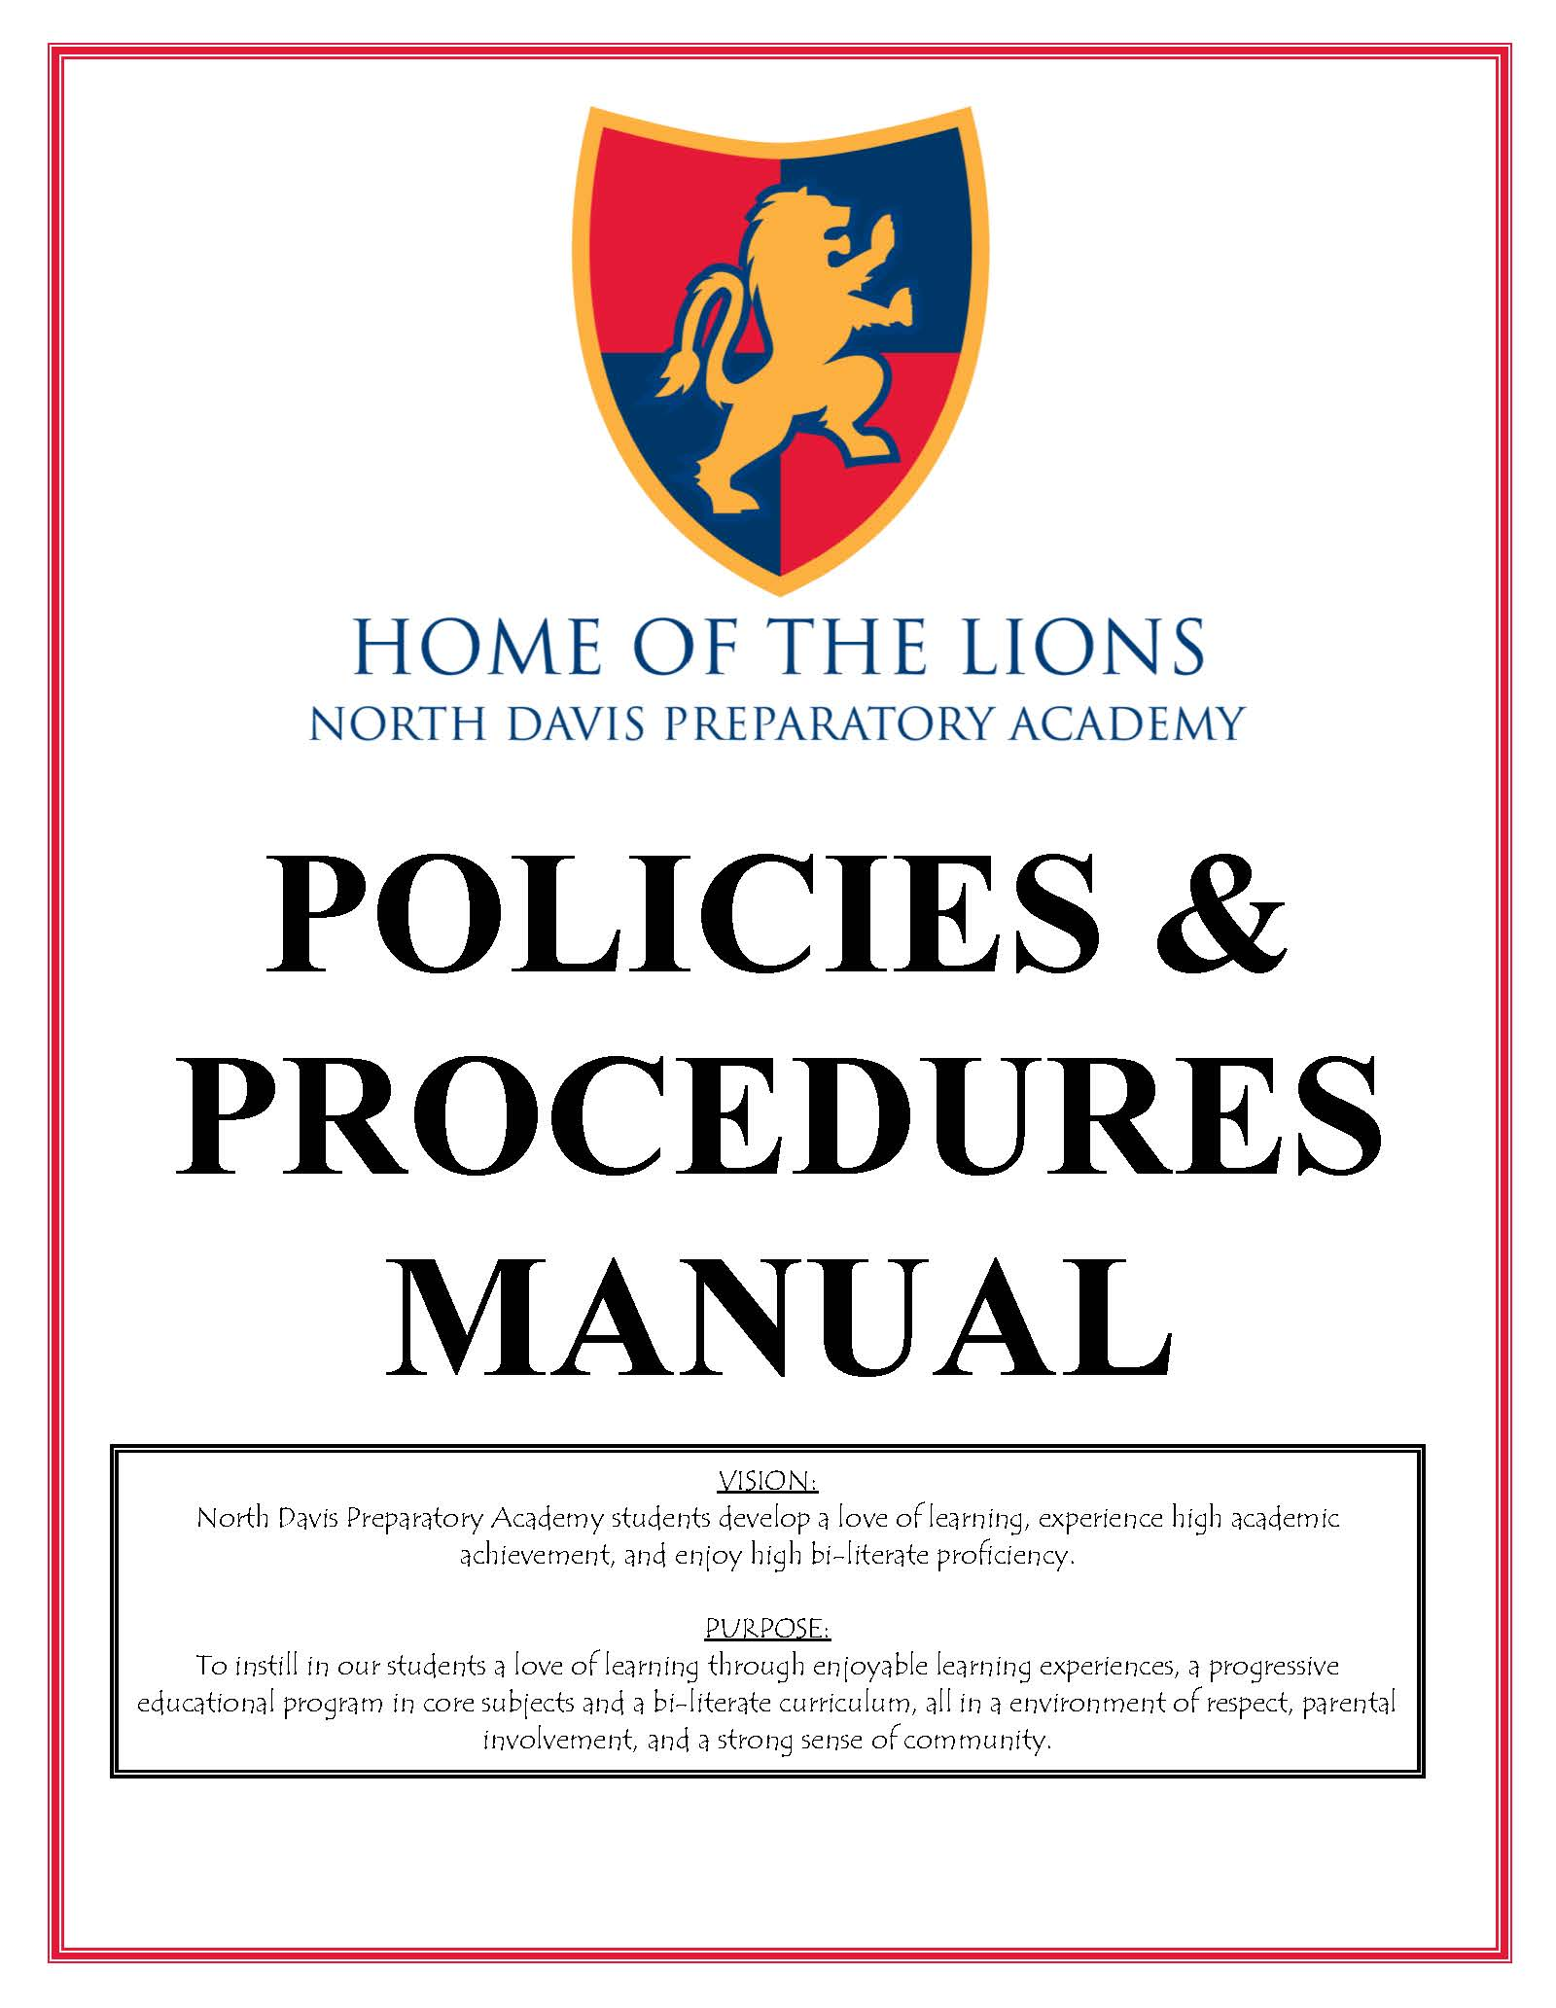
Parent & Family Engagement Policy
The Parent and Family Engagement gives specific activity and other opportunities for families and parents to be involved in the academic success of students. You can find the full policy in the Policies & Procedures Manual on the website.
NORTHDAVISPREP.ORG/POLICIES

Slide 7

How can you be involved?
Volunteer at the school
POET
NDPA Board Meetings
Come to Parent Teacher Conferences
Read website & Qué Pasa
Give us your feedback

Slide 8
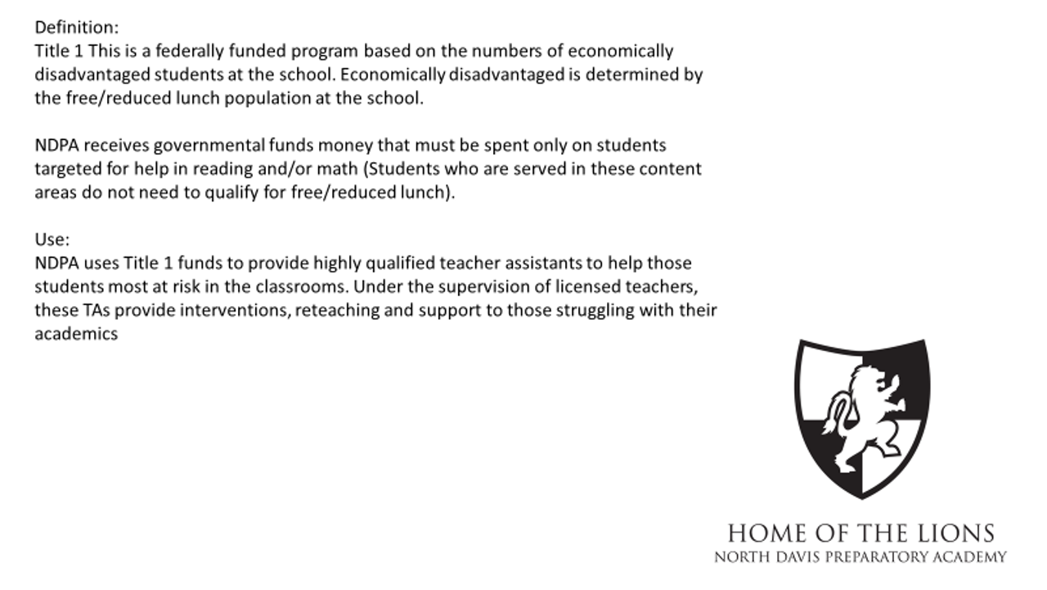
Where can I find info about the latest funding use?
NORTHDAVISPREP.ORG/POLICIES

Slide 9
CONTACT US
Kindergarten-4th
5th-9th
1765 W. Hill Field Road
Layton, UT 84041
Front office
Phone: (801) 547-1809
Fax: (801) 547-1649
1591 W. Hill Field Road
Layton, UT 84041
Front office
Phone: (801) 336-3601
Fax: (801) 336-3605
info@northdavisprep.org

Slide 10

Thank You!

